Slide 1
Placement Management System
Submitted by:
Vader Kings Team

Slide 2
INTRODUCTION
SYSTEM ANALYSIS
SYSTEM ARCHITECTURE
DB DESIGN
MODULES
WORKFLOW

Slide 3
INTRODUCTION
The purpose of the project is to eliminate manual work that makes the process slow and other problems such as inconsistency and ambiguity in operations. For the purpose of avoiding this, a Placement Management System is proposed, in which student information about placements in colleges and companies is managed effectively. Its purpose is to provide quick access to placement-related activities.

Slide 4
SYSTEM ANALYSIS
College looking for single platform for handling the activities with companies
Companies looking for single platform where they can reach out to multiple colleges and handle placement operations

Slide 5
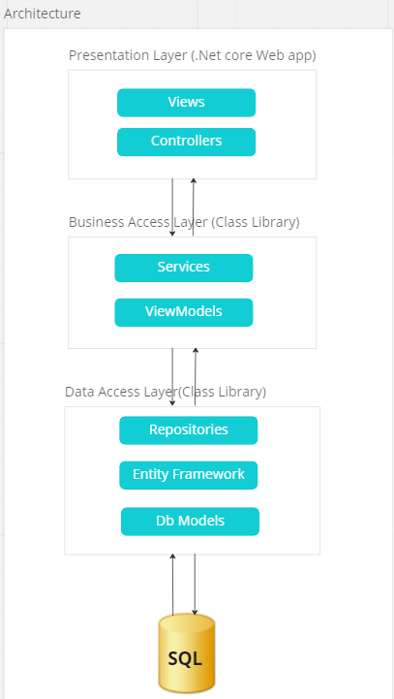
SYSTEM ARCHITECTURE

Slide 6
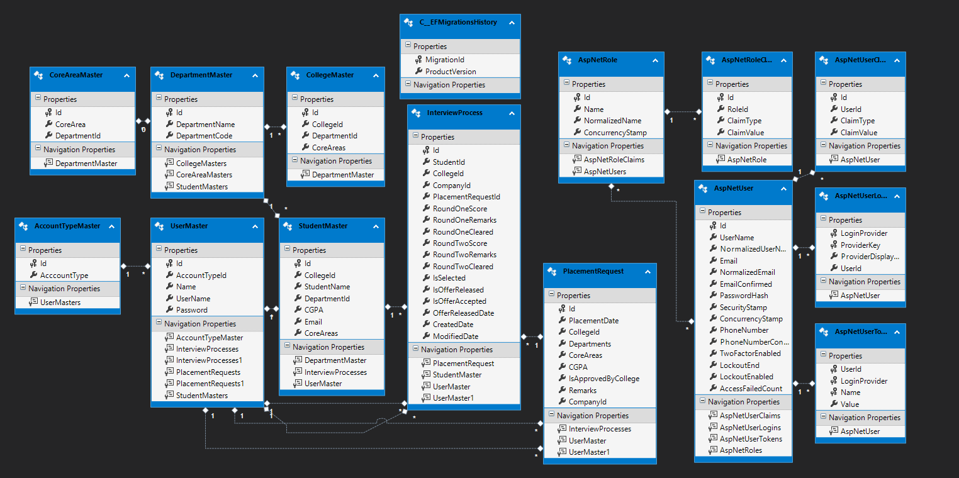
DB DESIGN

Slide 7
MODULES
Login
Registration
College dashboard
My profile
Add students
Review placement requests
View eligible candidates and Approve/Reject requests
Company dashboard
My profile
My placement requests
Add, Edit, Delete placement requests
Interview process for Approved requests
Update interview process of each students

Slide 8
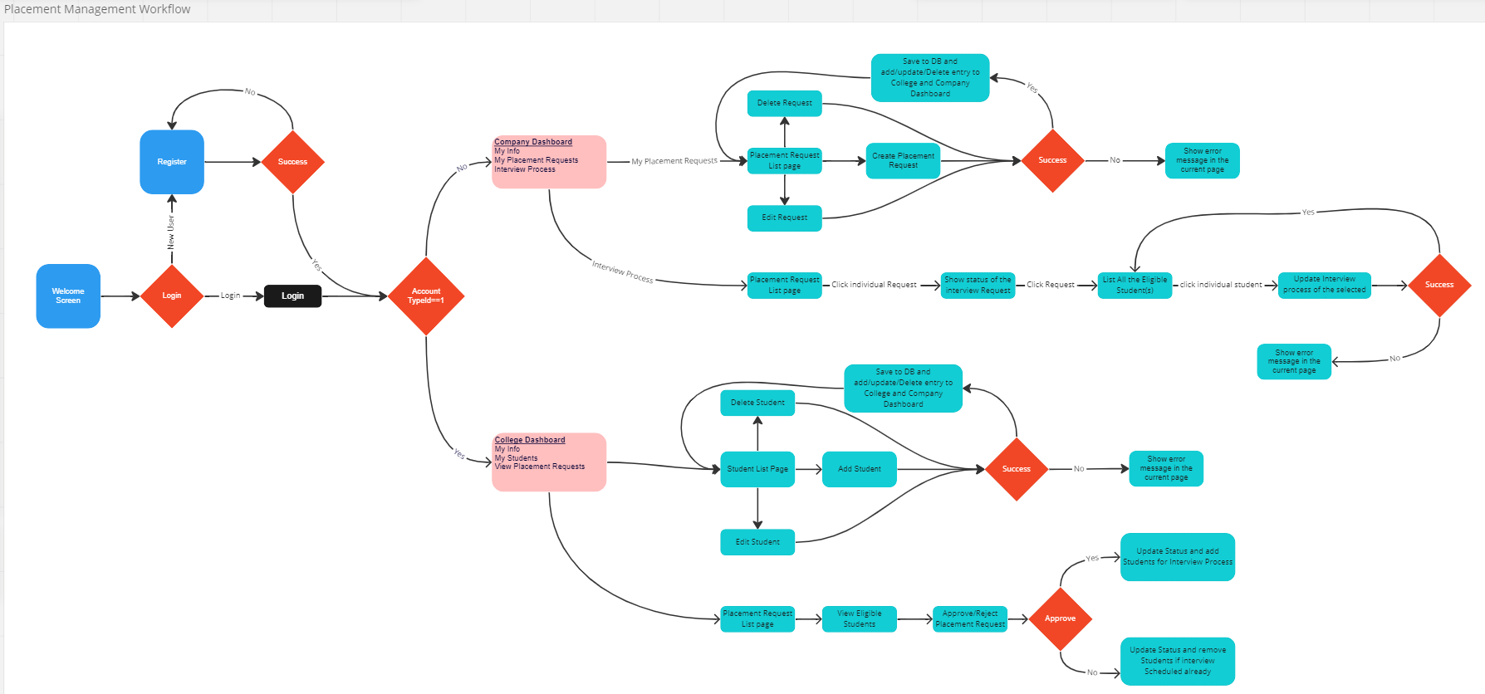
WORKFLOW

Slide 9
Thank you.

